Slide 1
Week 10 Contextual inquiry

Slide 2
Interaction design process
脈絡訪查 contextual inquiry
親和圖表 affinity diagram
構想發想 generate ideas
分鏡腳本 story board
原型製作design prototype
資料詮釋 data interpretation
Requirement analysis
&
Task analysis 任務分析

Slide 3
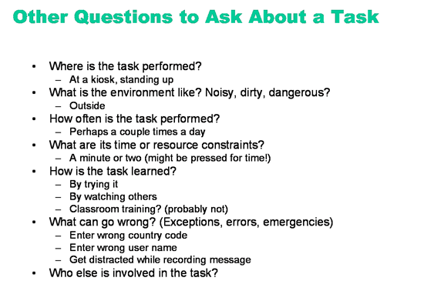
Notes:
There are lots of questions you should ask about each task. Here are a few, with examples relevant to the OMS send-message task.

Slide 4
Requirement activity 需求分析活動
Requirement 需求: a statement about an intended product that specifies what it should do or how it should perform. 描述產品功用及其如何運作
Two aims 目標
  Understand users, their work, and the context of that work 要了解使用者，其工作及使用情境
  Product a set of requirements as a basis to think about design 建立需求描述以做為設計基礎

Slide 5
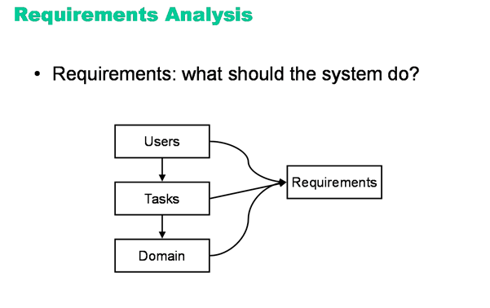
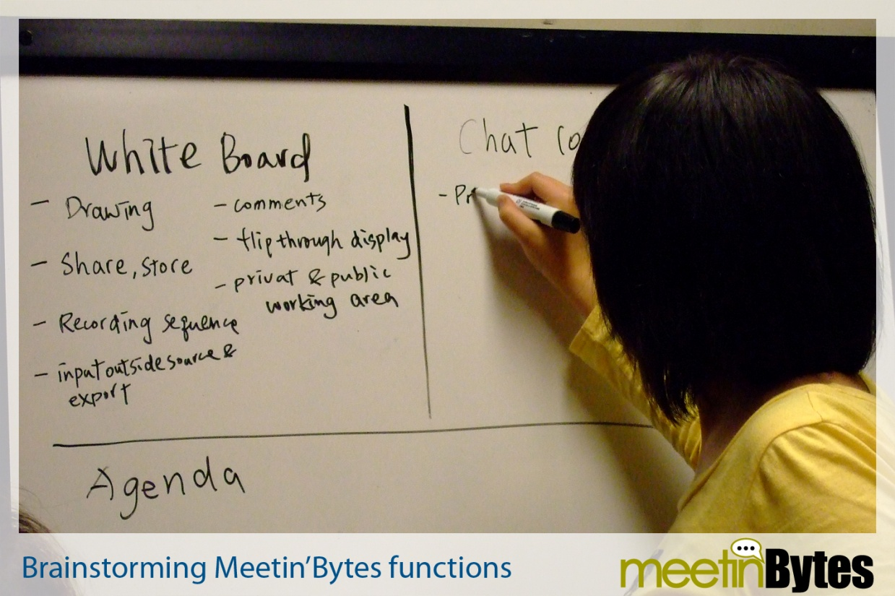
Notes:
http://courses.csail.mit.edu/6.831/archive/2008/lectures/L5-task-analysis/
User, task, and domain analysis feed into a more general process called requirements analysis, which creates a description of the system’s desired functionality and other nonfunctional properties (like performance, security, and capacity).
Without user and task analysis, requirements are incomplete. User and task analysis contribute additional functionality (tasks that users need to do which may not be evident from the domain analysis alone) as well as nonfunctional requirements about usability (like how efficient certain tasks should be, or how learnable, or how memorable) and about other properties of the system as well (e.g., accommodation for users’ physical limitations, like impaired vision). For example, here are some of the requirements in the OMS system that might come out of user and task analysis:

Slide 6
Contextual design 情境式設計
Karen Holtzblatt

Slide 7
Introduction
Usability testing was only bringing a 15-20% improvement to user experience.
過去蒐集user資料方法之不足: 只能發現問題點，但無法了解人們工作的情況
Marketing data gathered in surveys, focus groups and user group conference could target problem areas for customers, but could not give designer the detailed data that they needed about how people worked, what people did to get their jobs done.

Slide 8
Marketing techniques (focus group, survey…)未提供產品如何融入工作流程，以及使用者意圖及工作任務。
Contextual inquiry:
  going into the field to see …
  how work practice unfolds 工作實際情境 …
  to understand what people were really trying to do, and
  design new technology to support, extend, and transform that practice.
影片
設計施肥切碎機 design a human powered compost shredder for an urban organic farm http://www.youtube.com/watch?v=O8o7Tuh2RuM

Slide 9
Contextual design overview
Contextual design 定義:
  A full front-end design process that takes a cross-functional team from collecting data about users in the field, through interpretation and consolidation of that data, to the design of product concepts and a tested product structure.
The basic value of CD 基本價值: design from reliable data collected that represents the actual things that people do. 透過資料蒐集來呈現人們做事的實際情況，做為設計產品的基礎

Slide 10
Setting project scope
First step: set the project scope 設定計畫範圍 – decide how wide to open the inquiry and how much change the organization and its people are ready to make. (e.g. 人力點餐改為電腦點餐)
Wide scope 大範圍 — collect more data, make more models, and create more designs than a small scope. The wider the scope, the longer the process and the more resources required. 廣度需要考量設計團隊 (包含程式、介面設計…) 改變的意願
  了解某點餐系統 並予以改進(small) vs. 點餐可如何透過系統進行 (wide)
範圍越大，在現有設計上的改變越多

Slide 11
Defining the right process for the project
Factors influence the length of the project:
  How easy or difficult it is to set up the customer visits
  the number of users to be interviewed
  the number of work models to be consolidated
  the complexity of the design
  the number of people available to do the work.
  The time to communicate to others and to obtain organizational buy-in 採納.

Slide 12
The steps of contextual design
A. 情境訪談 The contextual interview – getting the right data
B. 解讀資料 Interpretation sessions – creating a shared understanding
C. 整合模式Consolidation – creating one picture of the customer
D. 想望新工作方式Visioning a new work practice
E. 故事腳本 Storyboarding – working out the details
F. 設計使用者環境 User environment design
G. 介面設計 User interface design and mock-up

Slide 13
Table 49.1. 情境設計的步驟
步驟 | 描述 | 目的
使用情景調查 (CI) | 在使用者工作時觀察並問問題。利用人種誌的技術收集資料 | 獲得使用者所從事、所關心和實際工作架構的相關資訊
闡釋階段和工作塑模(work modeling) | 獲取個人實際工作的一些關鍵議題。 利用5個工作模型將個人工作模型化。 每個模型紀錄實際工作的不同面向 | 對需在跨功能團隊中進行合作式設計的使用者產生多面向的了解。 提供一個取得複雜質性資料的方式

Slide 14
步驟 | 描述 | 目的
關聯(affinity)和工作模型強化 | 強化個人的工作模型和議題，以呈現某一族群的工作架構，但又不失去個體差異 | 產生關於一個用戶族群可重複使用的一致性資料，讓設計者在定義關鍵需求和刺激設計討論時有個遵循方向
視覺呈現和故事板(storyboard) | 利用產生一個觀於工作如何被改變的high-level故事(the vision)，來發想科技如何滿足使用者的實際工作需要。在每個任務階段(storyboard)將故事細節描述出來 | 確定科技可以適當融入使用者整體工作中。每個階段的科技發想要依據資料以避免破壞工作。並確保科技能夠支援工作

Slide 15
步驟 | 描述 | 目的
使用環境設計 | 設計一個顯示新系統各部份如何相互關聯的floor plan。呈現系統架構和群聚功能而不考量使用者介面與施行 | 確定系統中的工作流程可以支援工作。協助設計者將焦點放在系統工作流和功能上，而不是考量使用者介面和施行。創造支援計畫的代表系統
紙上雛型 | 利用使用者介面的紙上原型和使用者一同測試與修正系統設計。 讓使用者在紙上系統進行真實的工作，而不是只是評論和提供意見 | 提供一個可靠的談論方式，與使用者討論建議的系統。在將想法放進系統前先verify設計。深化系統需求。在交出系統前開始測試使用者介面的想法和產品概念
Notes:
協

Slide 16
A. THE CONTEXTUAL INTERVIEW- GETTING THE RIGHT DATA
  Requirement gathering is not simply a matter of asking people what they need in a system
  A product is part of a larger work practice. It is used in the context with other tools and manual processes.
  Product design – 利用科技的可能來 redesign of work or life practice
  無法直接問使用者設計上的需求 (E-learning system in NCTU)
    They do not understand what technology is capable of
    They are not aware of what they really do (unable to articulate their work practice.)
Notes:
944

Slide 17
Contextual inquiry
CD的第一步 -- contextual inquiry: the field data gathering technique that allows designers to go out into the field and talk with people about their work or lives while they are observing them.
利用一對一的訪談了解客戶工作
Contextual interview 的四個原則:
Context: gather data in the workplace while people are working
Partnership: collaborate with customers to understand their work. Let them lead the interview by doing their work. Do not come with planned questions.

Slide 18
Interpretation: determine the meaning of the customer’s words and actions together by sharing your interpretations and letting them tune 調整 your meaning.
Focus: Steer掌舵 the conversation to meaningful topics by paying attention to what falls within project scope and ignoring things that are outside of it.

Slide 19
Contextual inquiry 步驟
一開始為談話式訪談，接著開始觀察/討論與設計核心(design focus)有關的使用者工作。注意actions, verbal clues, and body language.
當雙方進入狀況後，討論到
  What is happening
  Why
  Implications for any supporting system

Slide 20
Choosing customers depends on project scope
訪談人數取決於計畫大小
Small scope (e.g. next product release, usability improvement) – 4-10 customers from 3-5 businesses covering 1or2 roles.
Large projects— 15-20 customers from over 4 businesses covering 3-5 roles.
Very large projects – 20-30 customers
Choosing customers (P. 945): 考量被觀察者的job title, 所屬industry, geography (產品國際化), and 使用type of technology

Slide 21
THE STEPS OF CONTEXTUAL DEISGN
B. INTERPRETATION SESSIONS – CREATING A SHARED UNDERSTANIDNG
  傳統的 presentations, reports, or email 無法有效了解蒐集到的資訊 (將觀點帶入 shared understanding)
  CD採用 interpretation teams in interactive sessions to review, analyze, and manipulate the customer data.
  Team組成: 4-6 people represent a wide range of job functions and viewpoints.
  方式: 不建議採用錄影錄音 (太花時間)。Within 2 days of each interview, rather the team in the design room, where the interviewer can tell the story of the interview from handwritten notes and memory.
Notes:
946

Slide 22
  Team members: 對這些訪問者發問問題，回溯及描述細節。同時perform interpretation session roles: recorder, model builder, moderator, participant.
  紀錄者將紀錄內容投影出去供大家看，紀錄內容被轉印在 3M post-it Notes上，作為之後畫 affinity diagram的依據
  Model builders利用這些草圖來繪製組成五種work models onto flip charts

Slide 23
Five work models
The flow model 描繪工作中個人負責部分、需要的溝通協調。
The cultural model 顯示公司內部政策或外部對於個人成員的影響。公司文化影響其價值與信仰，決定了內部人員的預期與行為等
The sequence model 執行任務的步驟及流程
The physical model 工作環境的外觀設計及其對於使用該科技產品所造成的限制。外在工作環境、溝通
The artifact model 顯示其他相關產品如何被使用，並建議其用途的延伸性

Slide 24
Five work models
Interpretation team 的運作: 每位成員帶入不同觀點來審視資料，採開放式討論方式，提出問題、激發訪問員的記憶、引出更多資料、得到設計想法。
此過程確認所有訪談中的相關訊息都能被轉換在設計過程中 and shared with key team members –
See the data and start design conversation about how to address the user’s needs with technology. 如何透過科技來滿足需要

Slide 25
Choosing work models depends on project scope
不同的工作模式圖及關係記錄 (affinity note) 針對在工作中的不同部分。依據 project scope大小的差異，不同的模式需要被使用，歸納如下:
Identifying key issues:
  Affinity diagram (關係圖) 可用來界定重要議題 key issues
Designing the next product release:
  如僅改善產品而非重新設計，僅需要affinity notes and the detailed models: the sequence, artifact, and physical layout of the work.

Slide 26
New product, market, or technology direction
  若需了解新產品市場，需要更廣的模式，Flow, cultural, and physical site model. These show you who the people are that could be supported and how they interrelate, how work is distributed across space.
Getting reusable corporate data:
  工作模式呈現工作中的基礎架構，因此是穩定不變的。多蒐集較廣的資料能夠供日後設計類似產品使用。

Slide 27
C. 整合模式 CONSOLIDATION – CREATING ONE PICTURE OF THE CUSTOMER
  設計者非使用者，系統的設計需要考量整個使用者族群而非個別狀況，enables teams to create one representation of a market so that they design addresses a whole population, not just one individual.
  當討論各模式的核心要素時，設計者想出如何設計產品以支援工作。Team members will synthesize the findings into a reasonable view of what a product needs to support

Slide 28
The consolidated models
The affinity diagram: organize all of the data, finding common underlying themes that across the customer population. 允許設計者從資料中提出設計想法，而非根據個人觀點。
The consolidated flow model:
  Show the roles (players) that a system must support
  show the pattern of relationship between players
  reveals opportunities for collaboration
  show how responsibilities are clustered into roles that can be supported.
  Reveals artifacts and information that pass between people that might be supported online.
Notes:
948

Slide 29
The consolidated cultural model:
  Show the influence, constraints, interpersonal friction磨擦，policies, standards, and law the people work under
  Reveals primary values and irritation in the market
The consolidated physical models
  Reveal physical constraints of distance, time zone, and overall physical and system access
  Reveals the way space is used and how people set up their offices to support their work
  Shows the whole social, physical, and cultural environment that the team will have to support.

Slide 30
5. The consolidated sequence model
  Similar to traditional task analysis – show each steps, triggers for the steps, strategies for achieving each intent, and breakdowns in the ongoing work.
  Show the work structure that the system will support or replace.
6. The consolidated artifact model:
  Reveal the structure of the artifact, how it is used, how it is presented, and the data that it represents.
  Help the team to redesign 可放上網的artifacts，或刪去無用的 artifacts。

Slide 31
How can so little data characterize a whole market?
Lasting consolidated data is built anywhere from 15 to 30 field interviews and can characterize markets of millions of people.
原因
  We are all different, but we are all alike.
  There are only so many ways to do work.
  Geographical differences are mostly about law

Slide 32
D. VISIONING A NEW WORK PRACTICE 想望新工作方式
幾個步驟 the team:
檢視一個個模式，沉浸在這些資料中 “Walk the data” model by model, immersing the team in customer data so their inventions will be grounded in the users’ work. 選擇想法來fit the needs of the population
Build a story of the new work practice
Draws on a flip chart that descries the new work practice, show people, roles, systems, and anything else the vision requires.
Evaluate each vision, list both the positive and negative points of the vision from the point of view of customer value, engineering effort, technical possibility, and corporate value.

Slide 33
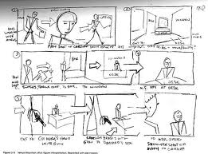
E. STORYBOARDING – WORKING OUT THE DETAILS
  Like freeze movies of the new
  work practice (see Fig. 49.9)
  Draws step-by-step pictures of how people will work in their new world.
  Include manual steps, rough user interface components, system activity and automation, and documentation use.
  They show what happens when the roles on the flow interact with the system and each other
Notes:
P.596

Slide 34
THE STEPS OF CONTEXTUAL DEISGN
F. USER ENVIRONMENT DESIGN
產品三個設計層面 layers:
  user interface
  implementation (object model)
  explicit work the product is performing (invisible)
The structure of the work of a product = the user environment design : it represents the structure, function, and flow of a system.

Slide 35
功能, it:
  focuses the team on designing the work structure and flow within the system.
  Enable designers to view the whole system and the relationships between its parts,
  Show how the system will structure the user’s work and how it will interface with other systems.
  Focus on the system’s function instead of jumping ahead to user interface issues or beneath to implementation issues.
  Ensure that designers think about the work pattern within the system without being distracted by discussions of icons, placement of function, or words on the user interface.

Slide 36
THE STEPS OF CONTEXTUAL DEISGN
G. USER INTERFACE DESIGN AND MOCK-UP
  How can you find out if the models are right and suitable? Users do not understand models.
  方法: use mock-ups of new design artifacts to test their ideas by having people use them in real work situations.
  Mock-up interviews using paper prototype help designers understand why design elements work or fail and identify new function.
  Test the prototype in users’ work context to keep them grounded in their real work practice.

